Slide 1
Conceptualisation
WP2 T3

Slide 2
Learning Objectives
Composing a content concept map
Preparing a syllabus

Slide 3
Concept Map
Outline the specific components of your training
Identify relationships
Check with the defined learning objectives
Types:
Hierarchical
Spider
Flowchart
etc.

Slide 4
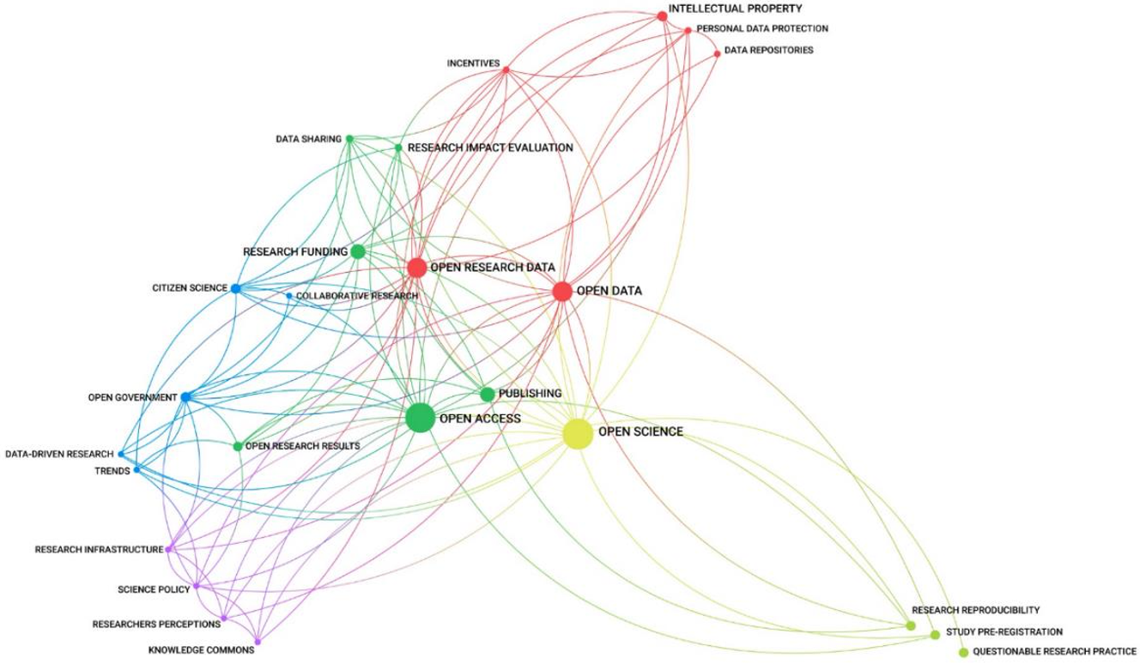
Open Science Concept Map

Slide 5
Concept mapping
Try building a concept map about your upcoming training
use any graphical tool or do it on paper
option: draw.io
category: Maps

Slide 6
Syllabus
The syllabus presents a high-level sequence outline
can be broken down into smaller subtopics later
Offers logical topics sequence
concepts introduced early help with the ones encountered later
The defined agenda should not be very rigid
Change the sequence of topics
Add or delete topics at a later stage
Should provide learners with the necessary information
help them decide if they want to follow the training
Incorporates all elements defined with the RDA minimal schema

Slide 7
Syllabus Template
Required document to be FAIR-by-Design
Must contain all elements provided in the template
You are free to change the layout in any way
Example: the syllabus for this training
The Syllabus Template is part of the Templates package
Ignore the header for now…
More on this later

Slide 8
Define a Syllabus
Try to develop your own syllabus for the Open Science for policy makers training
Use the information you gathered and defined in the previous activities
To edit the template you can download the file and use a simple text editor

Slide 9
Summary
Concept map
to get the creative juices flowing
Syllabus
to outline all essential information about the training in an RDA minimal schema compatible way
Next stop:
Granular learning content structure

Slide 10
Thank you! Any questions before we continue?
sonja.filiposka@finki.ukim.mk
To cite this presentation, please copy and paste: <Surname, Name. (Date). Pres title, occasion of the presentation. Link to presentation in Skills4EOSC community on Zenodo>

